Slide 1
Automatiseren tafels 3,2,5,10
tafels

Slide 2
1x3=

Slide 3
2x5=

Slide 4
3x10=

Slide 5
4x3=

Slide 6
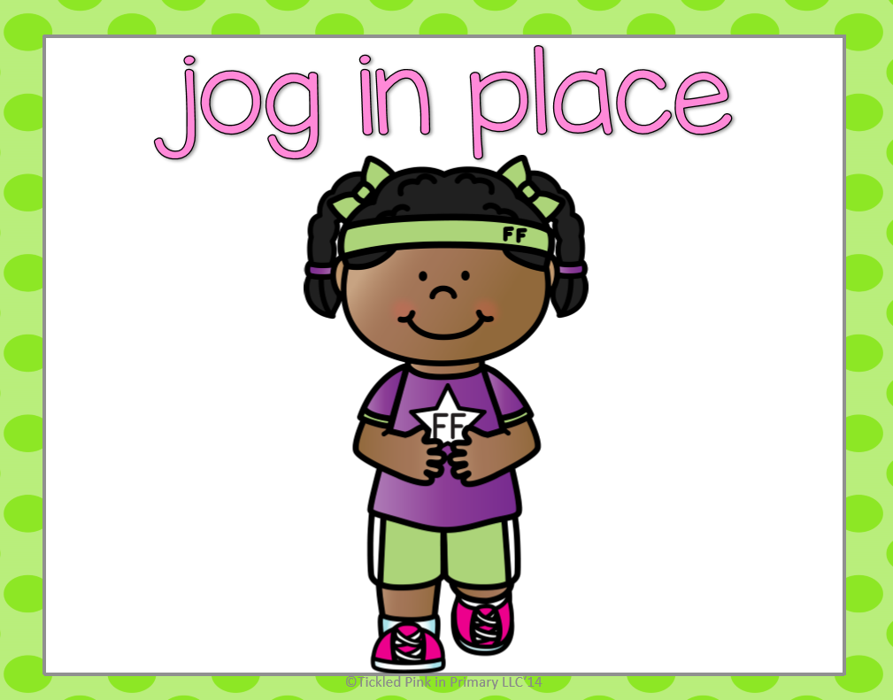

Slide 7
6x4=

Slide 8
6x3=

Slide 9
7x4=

Slide 10
2x10=

Slide 12
9x3=

Slide 13
10x3=

Slide 14
7x3=

Slide 16
6x5=

Slide 17
9x2=

Slide 18
8x4=

Slide 20
8x2=

Slide 21
5x4=

Slide 22
4x2=

Slide 24
4x5=

Slide 25
7x5=

Slide 26
3x4=

Slide 28
6x5=

Slide 29
2x2=

Slide 30
9x4=

Slide 32
10x10=

Slide 33
9x3=

Slide 35
6x3=

Slide 36
5x2=

Slide 37
3x3=

Slide 39
4x3=

Slide 40
6x5=

Slide 41
8x4=

Slide 43
2x2=

Slide 44
6x3=

Slide 45
10x5=

Slide 46
GOED GEDAAN KANJERS!!!!

